Slide 1
Knowledge Loss
Through zeal, knowledge is gotten;
through lack of zeal, knowledge is lost.
Let a man who knows the double path of gain and loss
thus place himself that knowledge may grow.
Buddha
Notes:
David Alt, MD
JAN 2019
Madigan Army Medical Center

Slide 2
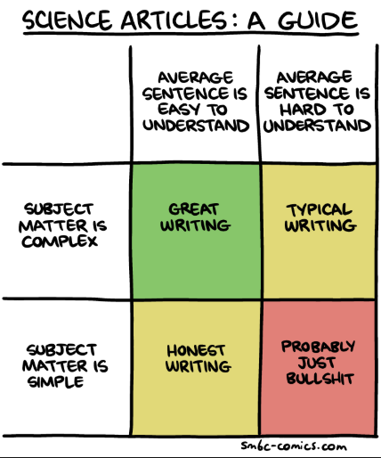
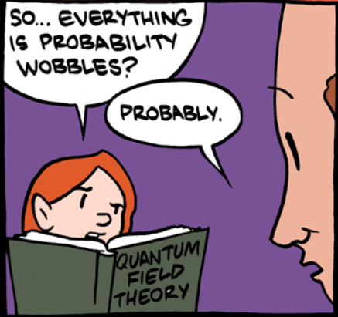
What is Knowledge?
Notes:
Excerpt from: http://www.smbc-comics.com/comic/2011-12-11

Slide 3
But First, Some Jargon ...
“... special words or expressions that are used by a particular profession or group
that may be difficult for others to understand.”
Knowledge loss: tacit knowledge lost when employees leave
Knowledge decay: knowledge in surviving employees decreases in value
Critical realism: aims to advance knowledge of the real world, and assumes it is so complex it can’t be captured by a single theory
“We’re only human, and don’t claim to understand the whole problem.”
Induction: the general is inferred from the particulars (empiricism)
“I’ve only seen white swans, thus all swans are white.”
Deduction: the particulars are inferred from the general (rationalism)
“All birds lay eggs, thus swans must lay eggs.”
Abduction (retroduction): “best available explanation” – but not necessarily right
“Because the sun rises on one side and sets on the other, it must be rotating around the Earth.”
Notes:
Unlike deductive reasoning, abductive reasoning yields plausible but not necessarily verified explanations.
It starts with a set of observations and looks for the most likely answer.
I really wanted an analogy with a platypus here, but couldn’t think of one.

Slide 4
Study Design & Methods
Longitudinal case study (3 years)
Purpose: to measure and manage the impact of knowledge loss
Population:
public-sector, knowledge-intensive organization with aging workforce
150 employees, mostly engineering and technical staff, management
Methodology: Critical realism
onerous annual survey (7 hours!)
interactive, continual cycle of reflection with management to evaluate and respond to the study’s outcomes
... “using abduction, deduction, and induction”
Interpretation:
critical realism approach
seeking “analytical generalizability”, not “statistical generalizability”
Notes:
Actual study was five years (2008-2013), but this paper focuses only on the first part (measuring KL and its impacts).
Aim “to operationalize knowledge loss”.
Organization stakeholders were intimately involved in design and implementation of study.
The study is highly granular and careful about using and expanding existing theoretical knowledge, HOWEVER ...
... much of that foundational theory is from the lead author’s previous research.

Slide 5
Framework for Measuring Knowledge Loss
Framework assumes employee turnover as the primary cause
Five domains (“concepts”), each with measurement constructs
Knowledge Resources
Psychological Construct
Learning Organization Capacity
Risk Management
Organizational Problems
Impacts of each domain
Notes:
The survey dealt with employee turnover and the first four domains.
Organizational problems involved working with senior management in the organization to evaluate and respond to the study’s outcomes.

Slide 6
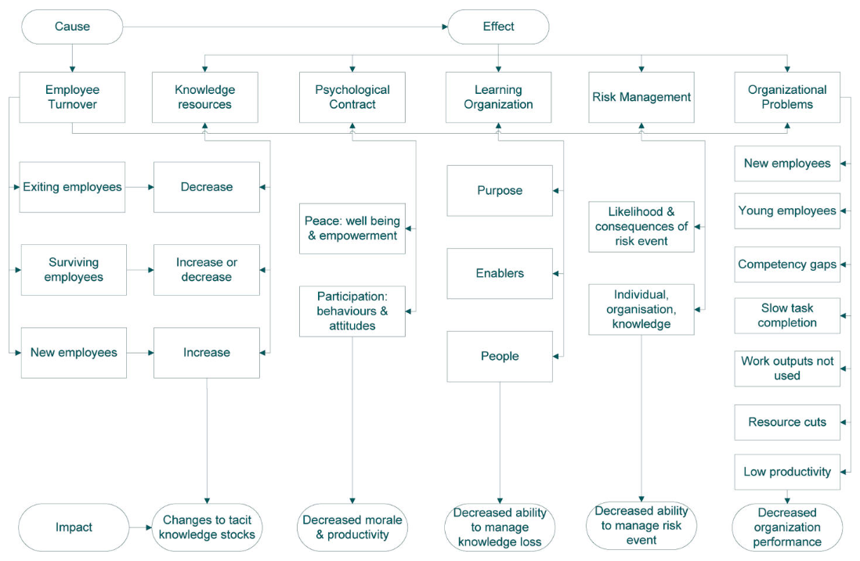

Slide 7
Cause: Employee Turnover
RQ1: Does employee turnover cause knowledge loss?
YES!
Employee turnover is dynamic, and knowledge is a fluid resource
Knowledge withdrawals: when employees exit
Knowledge decay: when survivors’ knowledge becomes less valuable
Knowledge deposits: when new employees enter
Knowledge growth: when survivors gain new knowledge
Notes:
High turnover: 49% of the staff who did the initial survey exited within two years.

Slide 8
Domain 1: Knowledge Resources
RQ2: How does knowledge loss change the organization’s knowledge resources?
Measures the magnitude and type of knowledge loss
Uses Massingham’s knowledge accounts model to measure the value of the individual’s tacit knowledge to the organization
 | Overall KA | Human Capital | Social Capital | Structural Capital | Relational Capital
2009 -> 2011 Mean Score | 51.4 -> 49.7 (-3.3%) | 62.6 -> 57.8 (-7.7%) | 65.1 -> 61.0 (-6.3%) | 50.6 -> 55.7 (+10.1%) | 27.2 -> 24.2 (-11%)
New employees as % of exiting employees mean score | 91.8% | 96.1% | 95.4% | 97.2% | 67.1%
Notes:
Massingham’s knowledge accounts model (2016). Curiously, it was this study that provided the validation for the model that was used. *cough*

Slide 9
Domain 1: Knowledge Resources
Overall KA doesn’t change very much, but doesn’t tell the whole story
Survivors’ KA remained stable (i.e., stagnant)
70% of top 20 performers exited; replacements were only 45% of top 20
Thus, knowledge was lost despite the new hires
What was lost?
Top performers had significantly higher mean scores:
relational (+101%) > structural (+31%) > social (+16%) > human (+14%)
It is important to understand who is leaving, and why.
Notes:
Massingham’s knowledge accounts model (2016)

Slide 10

Knowledge Accounts Measures
RELATIONAL CAPITAL
Formal Ties Number of external contacts External contact importance External frequency of contact External relationship Density Informal Ties External depth External purpose External knowledge flows External mentoring External social dependence External trust External reciprocity External friendship
Biggest losses
external knowledge flows
external reciprocity
Gains (new employees)
external purpose
external depth
Implications
Resilience from role-based relationships, vs relationships based on individuals
Notes:
External knowledge flows represents knowledge flowing from outside organizations to internal knowledge seekers.
External reciprocity refers to “in-kind” favors that are not necessarily economically based.
Losing these disrupts external social networks, causing decreased cooperation.
External purpose refers to building meaningful relationships with external contacts.
External depth measures the relationship in terms of how they help each other.

Slide 11
Knowledge Accounts Measures
STRUCTURAL CAPITAL
Currency Relevance Change Usage Sources Expert status Contribution Motivation Ability Action
Biggest losses
Usage
Action
Gains (new employees)
Usage
Expert Status
Implications
shift toward codified knowledge in absence of expert colleagues
Notes:
High usage: where best to store their knowledge and how to do it
High action: behavior in sharing their knowledge with the organization, e.g., more likely to codify it and share with others
Expert status: measures who is the best person to get information about structural capital sources

Slide 12
Knowledge Accounts Measures
SOCIAL CAPITAL
Colleagues’ Attitude Collective efficacy beliefs Collective outcome expectancy Network Structure Internal network size Internal density Internal heterogeneity Internal constraints Internal closeness Internal betweenness Network Quality Internal tie importance Internal corporate leadership Internal volunteering Internal mentoring Internal social dependence Internal reciprocity
Biggest losses
internal social dependence
internal corporate leadership
Gains (new employees)
internal network size
internal density
Implications
Employees build relationships quickly in culture of high turnover
Formal involvement in committees etc helps build social networks for new employees
Notes:
Social dependence: how much an individual is depended on by others at work; leaves survivors with no-one to turn to when they need help.
Corporate leadership: informal leadership contributions, like mentoring and advice. Losing this makes everything slower and less effective.
Who does this sound like? ... our champions
Internal network size: # contacts * seniority = volume of social contacts
Internal density: measures interconnectedness of social networks

Slide 13
Knowledge Accounts Measures
HUMAN CAPITAL
Employee Capability Activity Qualifications Experience Skills Knowledge Employee Sustainability Trust Careerism Employee Satisfaction Affective attachment Locus of control Calculative reward Calculative approval
Biggest losses
careerism
affective attachment
Gains (new employees)
calculative reward (but biggest loss for survivors)
locus of control
Implications
Granting independence and autonomy may help retention
Notes:
Careerism measures how much the employee sees their job as a stepping stone, thus high careerism is expected in people who leave.
Affective attachment is the bond a worker has with the organization (essentially, loyalty and satisfaction); in this case, many were retiring and not necessarily leaving due to job dissatisfaction, but may decrease morale and satisfaction for survivors.
Calculative reward refers to whether people work hard because they feel they will be rewarded.
Locus of control is the perceived sense of control over one’s life and work. The more cynical employees refer to this as “naive hope”.

Slide 14
Domain 1: Lessons
Important to understand who is leaving and why!
Relational capacity (external networking) is concentrated in top performers and more difficult to replace; role-based relationships may mitigate this
Our “champions” fit the profile for social losses and should be protected
Organizational memory depends on employees turning tacit knowledge into codified knowledge ... and being able to access it
Codified knowledge can mitigate tacit knowledge loss for motivated employees → MORE SHAREPOINT!
External relationships are important for staying up to date, providing fixes, and finding new best practices
Morale is important to prevent knowledge decay in survivors, especially calculative reward
More generally, supporting survivors mitigates knowledge loss!
Notes:
Massingham’s knowledge accounts model (2016)

Slide 15
Domain 2: Psychological Contract
Construct (% change, 2009-2011)
Peace (+6.8%) Work-life balance (+18.5%) Flexibility (+2.5%) Participation (+2.2%) Leadership (+8.8%) Recruitment and selection (+8.9%) Cross-unit cooperation (+11.3%) Learning and development (+1.7%) Involvement (+10.9%) Organizational culture (+3.8%) Rewards and recognition (-29.6%) Performance appraisal (-13.5%) Career management (+7.4%) Overall employee engagement (+4.5%)
RQ3: How does knowledge loss change psychological contract?
Psychological contract measures changes in employees’ emotional relationship with the organization
The unexpected positive results are attributed to management interventions
Implications
Employee turnover does not have a negative impact on psychological contract overall
Improving employee happiness (especially via work-life balance) builds resiliency to the negative impacts of organizational turnover
Core pride in one’s work is independent of happiness from “fringe benefits”
Notes:
Psychological contract: measures changes in employees’ emotional relationship with the organization
Low psychological construct scores at the start of the study led management to focus on improving them as a knowledge management intervention. Largely, they were successful ... in this domain.

Slide 16
Domain 3: Learning Organization
A Learning Organization ...
effectively manages its knowledge resources
responds to forces for change
learns from its experiences
Concepts
Purpose: measures the capacity to be flexible and responsive
Enablers: measures how well knowledge is captured and shared
People: measures the capacity to grow human capital through organizational learning
Notes:
LOC defines an organization that effectively manages its knowledge resources, responds to forces for change, and learns from its experience.

Slide 17
Domain 3: Learning Organization
RQ4: How does knowledge loss change learning organization capability?
Knowledge loss by employee turnover did not have a negative impact on LOC, assumed due to management interventions (i.e., knowledge management)
Notes:
LOC defines an organization that effectively manages its knowledge resources, responds to forces for change, and learns from its experience.

Slide 18
Domain 4: Risk Management
RQ5: How does knowledge loss change the organizations perception of risk and capacity to fill the gap necessary to manage risk?
Risk scores are calculated by risk managers ... if you have them
More than half the organization’s activities had no risk manager due to knowledge loss
“The outcome was the CSO was highly vulnerable because it does not know the likelihood or consequences of a risk event happening and cannot manage it.”
Survivors managed risk by depending on social capital
Notes:
Risk event: risk associated with losing knowledge in important activities
Level of exposure: likelihood and consequences of the risk occurring
Risk response: capacity to fill the gap
Surviving employees lack sufficient knowledge to gauge risk independently.

Slide 19
Domain 5: Organizational Problems
ORGANIZATIONAL PROBLEMS
New employees Young employees Competency gaps Slow task completion Work outputs not used Resource cuts Low productivity
RQ6: How are organizational problems affected by knowledge loss?
This encompasses the measure-intervene cycle of the project with management
After implementing knowledge management in the face of knowledge loss, do these problems continue or worsen?
Notes:
Organizational problems measures how well the organization is managing knowledge loss.

Slide 20
Domain 5: Organizational Problems
ORGANIZATIONAL PROBLEMS
New employees Young employees Competency gaps Slow task completion Work outputs not used Resource cuts Low productivity
New employees: organizational inactivity during training cost $1.25 million
Younger employees: fewer mature workers prevented organization from completing 100 critical tasks/week and 238 routine tasks/week, costing $9.1 million
Competency gaps by inadequate replacement workers cost $10.1 million
Slow task completion due to inexperience and workplace disorientation cost $1.9 million
Notes:
Competency gaps and slow task completion plague our MHS Genesis implementation.

Slide 21
Domain 5: Organizational Problems
ORGANIZATIONAL PROBLEMS
New employees Young employees Competency gaps Slow task completion Work outputs not used Resource cuts Low productivity
Work outputs not used: activities w/o risk managers created high agency costs, resulting in customer dissatisfaction with the work produced, and employees demoralized trying to persuade customers to take their advice. This wasted negotiation time cost $15.5 million
Resource cuts (like loss of risk management) lowered morale and increased external costs by $12.6 million
Low productivity from demoralization and inexperience cost another $9.2 million
Notes:
“Work outputs not used” reflects our current situation with MHS Genesis solution building.

Slide 22
Domain 5: Organizational Problems
ORGANIZATIONAL PROBLEMS
New employees Young employees Competency gaps Slow task completion Work outputs not used Resource cuts Low productivity
Total estimated cost due to knowledge loss:
$60 million for a 100-employee organization with an annual salary budget of $20 million
This, despite active knowledge management efforts by the organization when it had access to detailed information about the impacts through this study.
More than anything else, this underscores the costs of knowledge loss even in the face of mitigation.
Notes:
Organizational problems measures how well the organization is managing knowledge loss.

Slide 23
Study Findings: Recap
Employee Turnover: net knowledge loss
Knowledge Resources: overall KR comparable, demonstrating organizational resilience, but certain types of valuable knowledge are lost
Psychological Contract: no impact, possibly due to intervention
Learning Organization: no impact, possibly due to intervention
Risk Management: significant negative impact
Organizational Problems: knowledge loss expensive despite management
Notes:
Knowledge is not equally replaced by incoming employees.
There is a common theme in the authors’ interpretations: when there is a negative impact (as expected), it is assumed to be logical. .
Where findings were contrary to expectations, it is assumed due to knowledge management interventions. However, there was no detailed analysis that would prove this.
~ abduction/retroduction is convenient.

Slide 24
Implications for MHS Genesis?
Realize there are multiple best practices depending on the context or situation
Embed an expert (e.g., Cerner or DHA) who can build rapport and trust and has the expertise to make sense of complicated process
Involve organization stakeholders in design and implementation, with frequent reflection and feedback
Monitor and protect morale as a measure of employee knowledge (b/c it affects how knowledge is applied)

Slide 25
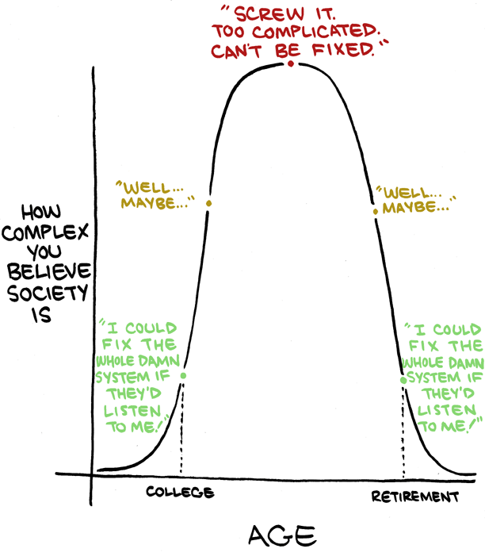
David
Justin
Darshan
John
MHS Genesis
Liam
Dr Marshall

